Slide 1
SPED 790: Methods for Learners with Higher-Functioning Autism Spectrum Disorder
Zack Cartmel
Master’s in Autism Spectrum Disorder
April 21, 2019
Dr. Glennda McKeithan

Slide 2
Definition of High-Functioning Autism (HFA)
Autism is a spectrum
Autism is a neurological, developmental disorder
Individuals with high-functioning autism exhibit
  Good concrete language skills
  Difficulty with back and forth conversations
  Awkward social skills
  Restricted interest
  Normal to high cognitive skills
It is a lifelong disorder
Requiring very substantial support
Avoids social interaction
No spoken language
Requiring much support
Tolerates social interaction
Limited speech
Would benefit from support
Age inappropriate social skills
Highly verbal
Learning problems
Repetitive movements
Unusual learning style
Severe inflexibility
Literal thinking
Extreme sensory sensitivity

Slide 3
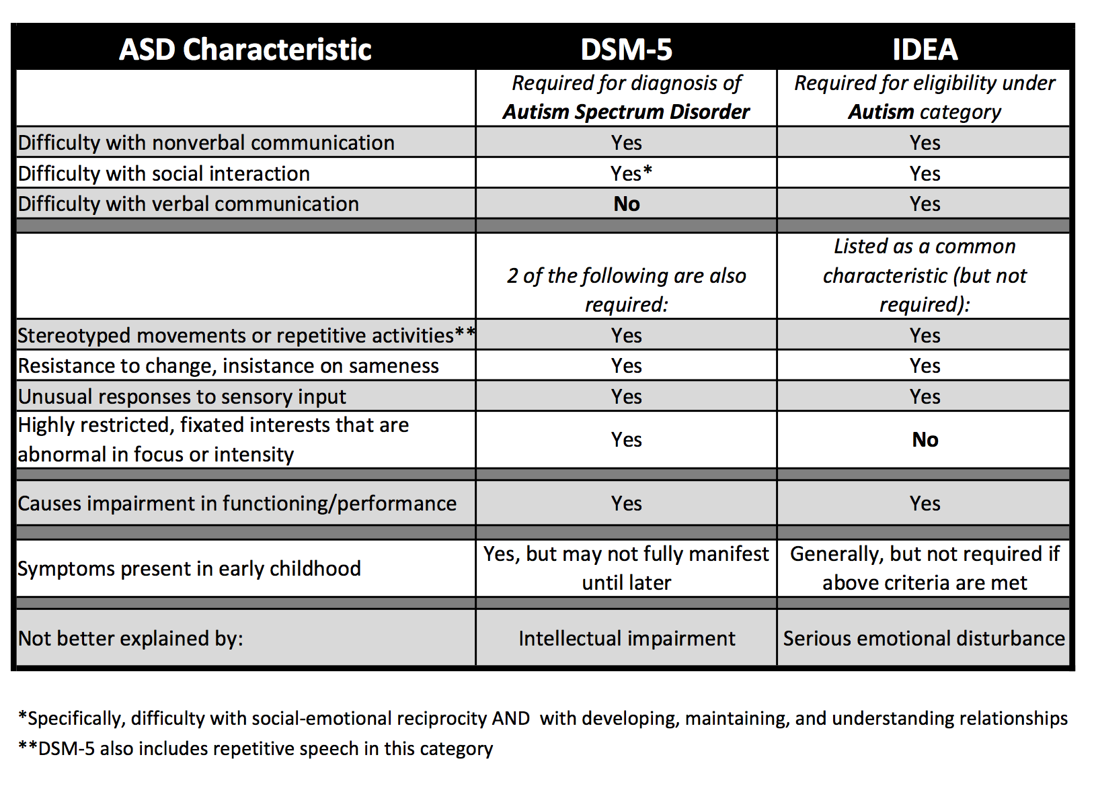
Diagnosis – Identification Process
Formal (norm-referenced measures) and informal assessments used by a multidisciplinary team to diagnose and identify ASD
Formal assessments
  Autism Diagnostic Observation Schedule, 2nd edition (ADOS-2)
  Autism Diagnostic Interview - Revised (ADI-R)
  Gilliam Autism Rating Scale (GARS-3)
  Asperger Syndrome Diagnostic Scale (ASDS)
Indirect Observation Measures
  Deficits in social interaction
  Parent interviews
  Learning characteristics
  Observable Problem Behaviors
  Deficits in social communication
  Restricted and repetitive patterns of behavior, interests, or activities

Slide 4
Characteristics of HFA
Social
Communication
Restricted interests
Awkwrd social skills
May act younger than their age
Unusual eye contact
Inappropriate mannerisms
Good concrete language skills
Difficulty with back and forth conversations
Abnormal affect - Shows no emotion or too much emotion
Cognitive
Only interest in one subject in school
Get a lot of excitement or pleasure from special interests
Normal to high cognitive skills
Literal thinkers
Approximately 30% have gifted IQ scores
Detail oriented – struggle with big picture

Slide 5
The Need for EBPs in HFA
National Professional Development Center
National Standards Project, Phase 2
Wong et al., 2014
Identified 27 EBPs
National Autism Center, 2015
Identified 14 EBPs
Interventions used for students with HFA should be evidence based
EBPs have undergone research to prove they are efficacious and valid
EBPs have been systematically reviewed by an outside source to determine that they are evidence based
Each group had different criteria leading to different results

Slide 6
Recommended EBPs for Academic Skills
Reinforcement
Task analysis
Visual support
A consequence following a behavior that increases the likelihood of that behavior occurring in the future
Could include token economy, special interests, and can be used with other EBPs
An activity or behavior is divided into smaller steps in order to teach the overall skill
Can be used with other EBPs
Can be used to break large assignments into manageable pieces
Any visual display that supports the learner engaging in the desired behavior or skill
Can include pictures, words, objects, visual boundaries, schedules, maps, etc.
Can help a student with organization skills, or knowing what they need for a class

Slide 7
Recommended EBPs for Social Skills
Social narratives
Self-management
Video modeling
Narratives that describe a social situation and highlight relevant cues and examples of responding
Individualized for the learner
Social Stories, Power Cards, etc
Focuses on learners discriminating appropriate and inappropriate behaviors, accurately recording and monitoring their own behavior, and rewarding themselves
Visual model of the target behavior or skill provided through video recording to help the student learn or engage in the desired behavior or skill

Slide 8
Demonstration of EBPs
Reinforcement
Task Analysis
Social narratives
Self-management

Slide 9
Resources for Parents, Educators, and Families
Guide to Evidence Based Practices:
  https://autismpdc.fpg.unc.edu/sites/autismpdc.fpg.unc.edu/files/2014-EBP-Report.pdf
Screening Recommendations from the CDC
  https://www.cdc.gov/ncbddd/autism/hcp-screening.html#Screening
The world needs all kinds of minds – Temple Grandin
  https://www.youtube.com/watch?v=UKhg68QJlo0
Dunn, W. (2014). Sensory Processing: Identifying Patterns and Designing Support Strategies In K. D. Buron & P. Wolfberg (Eds.), Learners On The Autism Spectrum (2nd ed., pp. 132–151). Shawnee Mission, KS: AAPC Publishing.
Myles, B. S., & Hubbard, A. (2005). The Cycle of Tantrums, Rage, and Meltdowns in Children and Youth with Asperger Syndrome, High-Functioning Autism, and Related Disabilities. In Inclusive and Supportive Education Congress International Special Education Conference Inclusion: Celebrating Diversity.

Slide 10
References
Autism Spectrum Therapies. (2012, June 8). The value of self-management in autism therapies [Video file]. Retrieved from https://www.youtube.com/watch?v=hnmbC-NKXWk
Cox, A., & AFIRM Team. (2018). Video modeling. Chapel Hill, NC: National Professional Development Center on Autism Spectrum Disorder, FPG Child Development Center, University of North Carolina. Retrieved from http://afirm.fpg.unc.edu/video-modeling
DrBlackwellFlanagan1. (2016, June 9). Social narratives [Video file]. Retrieved from https://www.youtube.com/watch?v=SVfeeh6yhSo
Emaley McCulloch. (2013, March 6). Autism Training Solutions: Chaining and task analysis [Video file]. Retrieved from https://www.youtube.com/watch?v=wMVZQICUhAk
Lee Health. (2018, April 14). Is Asperger’s syndrome autism? [Video file]. Retrieved from https://www.youtube.com/watch?v=8Pc2gSDLW8k
Sam, A., & AFIRM Team. (2015). Reinforcement. Chapel Hill, NC: National Professional Development Center on Autism Spectrum Disorder, FPG Child Development Center, University of North Carolina. Retrieved from http://afirm.fpg.unc.edu/reinforcement
Sam, A., & AFIRM Team. (2016). Self-management. Chapel Hill, NC: National Professional Development Center on Autism Spectrum Disorder, FPG Child Development Center, University of North Carolina. Retrieved from http://afirm.fpg.unc.edu/self-management

Slide 11
References
Sam, A., & AFIRM Team. (2015). Social narratives. Chapel Hill, NC: National Professional Development Center on Autism Spectrum Disorder, FPG Child Development Center, University of North Carolina. Retrieved from http://afirm.fpg.unc.edu/social-narratives
Sam, A., & AFIRM Team. (2015). Task analysis. Chapel Hill, NC: National Professional Development Center on Autism Spectrum Disorder, FPG Child Development Center, University of North Carolina. Retrieved from http://afirm.fpg.unc.edu/task-analysis
Sam, A., & AFIRM Team. (2015). Visual supports. Chapel Hill, NC: National Professional Development Center on Autism Spectrum Disorder, FPG Child Development Center, University of North Carolina. Retrieved from http://afirm.fpg.unc.edu/visual-supports
Seth Lapic. (2009, October 6). Positive reinforcement – The Big Bang Theory [Video file]. Retrieved from https://www.youtube.com/watch?v=JA96Fba-WHk
TED-Ed. (2013, February 10). The world needs all kinds of minds – Temple Grandin [Video file]. Retrieved from https://www.youtube.com/watch?v=UKhg68QJlo0
Wong, C., Odom, S. L., Hume, K., Cox, A. W., Fettig, A., Kucharczyk, S., … Schultz, T. R. (2014) Evidence-based practices for children, youth, and young adults with Autism Spectrum Disorder. Chapel Hill: The University of North Carolina, Frank Porter Graham Child Development Institute, Autism Evidenced-Based Practice Review Group.

Slide 12
Reflection
I thought that completing this presentation was useful for reviewing the important pieces of information I have learned through this course. I also like that we are required to share it with someone because it gives us the opportunity to show what we know as well as allowing us to create a resource for teaching others more about ASD. It is good to pick out what things are most important to include and what can be left out when you’re considering educating a “layperson” about autism. I will definitely use this to share with my supervisor and show her what I know and have learned.

