Slide 1
SPED 785: Application of Assessment Information for Exceptional Children and Youth: Autism Spectrum Disorder
Zack Cartmel
Master’s in Autism Spectrum Disorder
March 2019
Dr. Glennda McKeithan

Slide 2

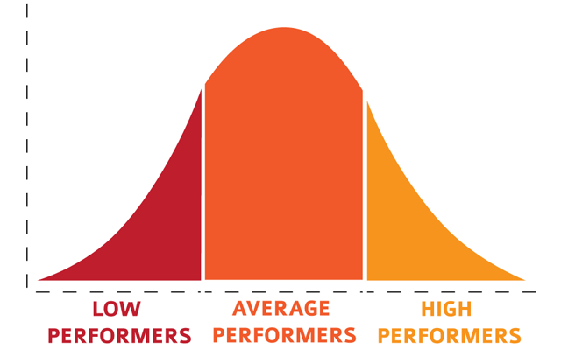
Assessment: Key Terms and Concepts
Formal Assessment
Informal Assessment
Standardized measurement of students’ performance and achievement
Criterion referenced
  Most common
  Compares student performance to a set of criteria such as expected grade level performance or developmental level
  Results either meet or fail to meet criteria
Norm referenced
  Compares student to others who took assessment
  Can be scored by percentile ranks
  Results graphed on bell curve: some students perform very well, most perform in the middle, some perform very poorly
Performance driven measures
Structured observations
Portfolio assessment
Curriculum based measures
  Ongoing measurements of performance that use weekly timed probes based on curriculum content
  Helps a teacher actively monitor progress and current level of performance

Slide 3

Assessment: Key Terms and Concepts
Basal – the starting point of an assessment
  Pre-determined by age or grade level
  Students automatically given credit for all items before basal
Ceiling – the stopping point
  Based on predetermined number of consecutive errors or errors in a given sample
Central Tendency Terms
  Mean – mathematical average of the data set
  Median – equivalent to the 50th percentile, the score below which 50% of the data falls
  Mode – most frequently occurring score in a distribution of scores

Slide 4
ASD Screening Process
3-tiered model
Tier 1 – Case Finding
Recognize risk factors/warning signs of ASD
Tier 2 - Screening
Use standardized screening tools
Scores can indicate approximate severity of ASD symptoms
Tier 3 – Comprehensive Developmental Assessment
Students who meet criteria in Tier 2 screening should be referred for comprehensive developmental assessment
Helps determine special education eligibility and services
Atypical social and/or communication behaviors
Difficulty with social interaction
Problems with attention, impulse control, and behavioral regulation
Narrow range of interests
Delays in language
Repetitive behaviors, inflexibility, and difficulty transitioning
Failure to make friends, understand social conventions, or display social reciprocity
Autism Spectrum Rating Scale (ASRS)
Autism Spectrum Screening Questionnaire (ASSQ)
Social Communication Questionnaire (SCQ)
Social Responsiveness Scale (SRS-2)
Screening results shared with parents and school-based team to start planning for intervention and further observation
Should include
Parent interviews
Developmental history
Direct observations and interaction with student
Quantitative measures of social behavior, cognitive functioning, academic achievement, language and communication, adaptive behavior, sensory processing, and atypical behavior
Develop individualized intervention plan

Slide 5
ASD Assessment Process
Results determine eligibility and special education services, help develop individual intervention plan, and guide IEP development
Important factors: Symptoms of ASD and co-occurring childhood disorder
Developmental history
Family medical history
Academic achievement
Communication and social reciprocity
Restricted and repetitive behaviors
Goals: determine the presence and severity of ASD symptoms, develop interventions, and collect data to help with progress monitoring
Core Assessment Domains:
Record Review
Developmental/Medical History
Medical Screening/Evaluation
Parent/Caregiver Interview
Direct Child Observation
Parent/Teacher Ratings of Social Competence
Cognitive/Intellectual Assessment
Academic Assessment
Social Communication and Language Assessment
Assessment of Restricted and Repetitive Behavior
Adaptive Behavior Assessment

Slide 6
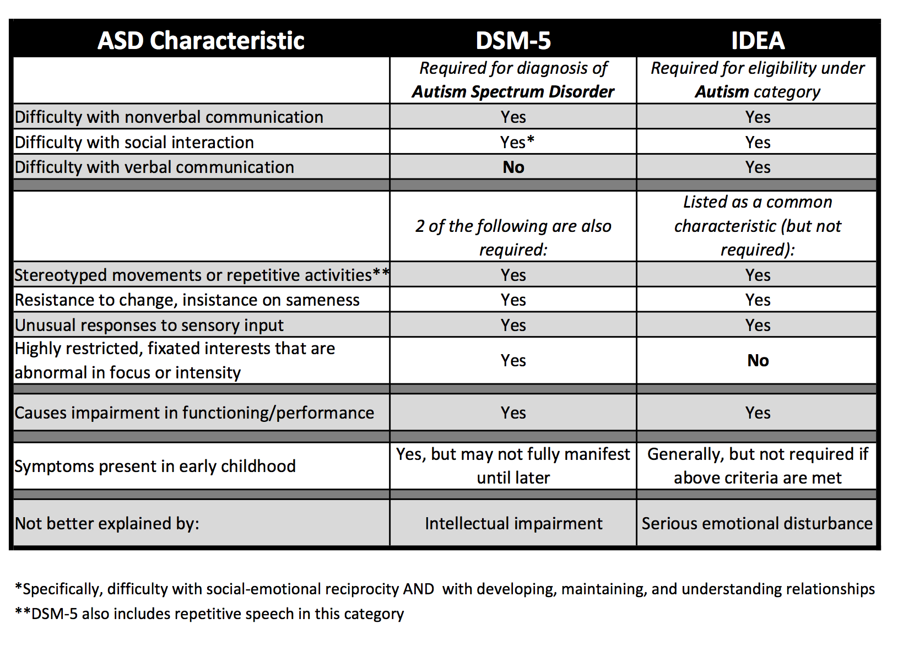
Comparison of DSM-5 (Diagnostic and Statistical Manual of Mental Disorders) and IDEA (Individuals with Disabilities Education Act
A medical diagnosis of autism does not qualify a child for special education services

Slide 7

ASD Observations: Best Practice
Observation should take place throughout the assessment and intervention planning process
Observation should occur in both structed and unstructured (or natural) environments
Parents assist with developmental history and behaviors that are associated with ASD
Direct Observation Measures
Autism Diagnostic Observation Schedule, 2nd edition (ADOS-2)
Childhood Autism Rating Scale (CARS)
Indirect Observation Measures
Deficits in social interaction
Deficits in social communication
Learning characteristics
Restricted and repetitive patterns of behavior, interests, or activities
Observable problem behaviors

Slide 8

Assessment: Best Practices and Procedures
Best practice includes
  Interviews and observation schedules
  Assessment of social behavior, language and communication, adaptive behavior, motor skills, sensory issues, atypical behaviors, and cognitive functioning
Interdisciplinary team approach is important
  Psychologist, general and special educators, speech/language pathologist, occupational therapist, physician
Use of multiple measures is important
  Instruments required to have strong reliability and validity
  Show effectiveness in diagnosis, clinical formulation, intervention planning, and outcome assessment
Individuals who administer, score, and interpret instruments should have formal course work in psychological tests and measurements

Slide 9
Measures for Assessing the Core Domains of ASD
Direct Observation
ADOS-2
Parent/Teacher Report
ADI-R
CARS-2
ASRS
SCQ
SRS-2
Academic Achievement
KTEA-3
WIAT-III
WJ IV ACH
Cognitive/Intellectual
DAS-II
SB-5
WISC-V
WPPSI-IV
Leiter-3
Social Communication and Language
CASL
Restricted and Repetitive Behavior
RBS-R
CCC-2
PLSI
SLDT-E
TOPL-2
CELF-5
EOWPVT-4
PPVT-4
TACL-4
RBQ-2
Adaptive Behavior
ABAS-3
DP-3
VABS-II

Slide 10
Interpreting and Applying Test Results: Score Terms
Standard deviation
Indicates the amount of variability in a group of scores
Raw scores
The number of correct items on an assessment
Standard score
A score that has been changed to fit a normal curve with a mean and standard deviation that remain the same
Allows us to compare a child’s performance on several tests and to compare on child’s performance to the performance of other students
Percentile rank
Tells what percentage of students performed equal to or worse than the student
Example: 95th percentile, 95% of students scored the same as or worse than the student
T score
Expresses test performance, has a mean of 50 and a standard deviation of 10
Z score
Indicates how many standard deviations a score is above or below the mean, has a mean of 0 and a standard deviation of 1
Stanine
Divide a destruction into nine parts

Slide 11
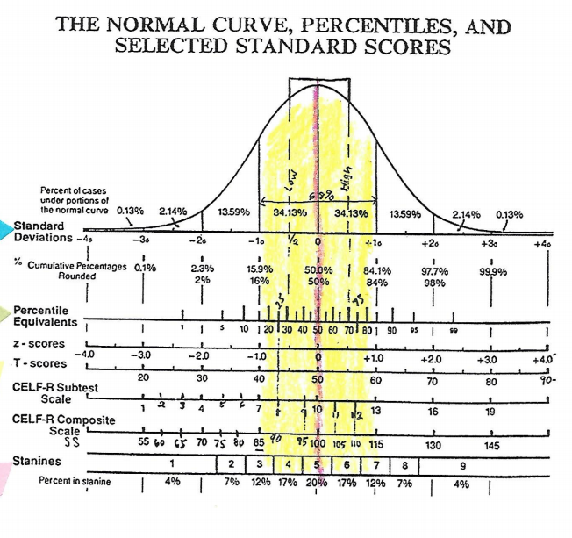
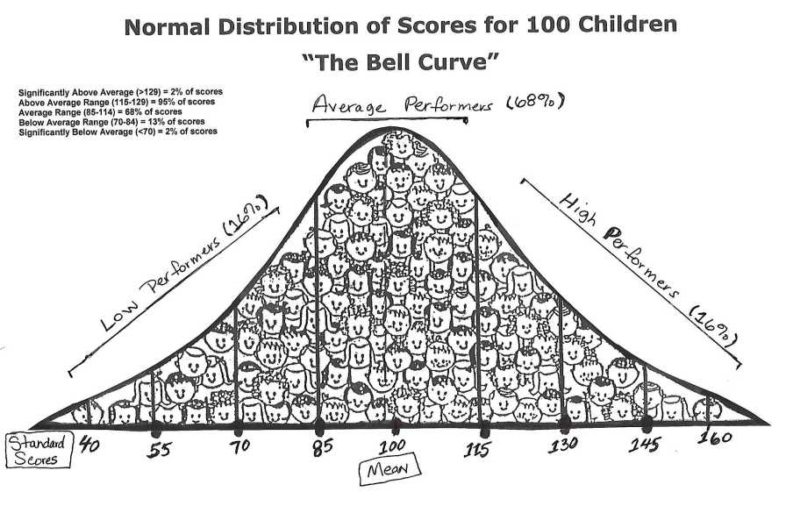
Interpreting and Applying Test Results: Helpful Guides
This conversion chart can be helpful in understanding different types of scores

Slide 12

Interpreting and Applying Test Results: Evidence-based Practices
Skill deficits should be addressed using evidence-based practices
Examples:
  A functional behavior assessment could be used identify the function of a behavior that scores highly on a behavior assessment
  Reinforcement could be used to increase the occurrence of prosocial behaviors
  Video modeling could be used to teach a student adaptive behaviors

Slide 13
Resources for Parents, Educators, and Families
Guide to Evidence Based Practices:
  https://autismpdc.fpg.unc.edu/sites/autismpdc.fpg.unc.edu/files/2014-EBP-Report.pdf
Q & A on IDEA 2004: Purposes and Key Definitions:
  https://www.parentcenterhub.org/qa1/
Categories of Disabilities Under IDEA
  https://www.parentcenterhub.org/categories/
Help with the IEP Process for Parents
  https://files.eric.ed.gov/fulltext/ED512611.pdf
Early Signs of Autism
  https://www.nationalautismcenter.org/autism/early-signs/
Screening Recommendations from the CDC
  https://www.cdc.gov/ncbddd/autism/hcp-screening.html#Screening

Slide 14
References
American Academy of Special Education Professionals (n.d.). Basic statistics and scoring terminology used in assessment. In Understanding Assessment in Special Education. Chapter 8‐ Basic Statistics and Scoring Terminology Used in Assessment.
Assignment on Score Interpretation. [Charts]. Retrieved from https://kuconnect.ku.edu/courses/1598/assignments/37494?module_item_id=110083
Mccaveman1975. (2017, February 9). Video modeling brushing teeth – autism [Video file]. Retrieved from https://www.youtube.com/watch?v=-fYuMzA9Js8
Presentations on the role of assessment in special education. [PowerPoint slides]. Retrieved from https://kuconnect.ku.edu/courses/1598/pages/m1-presentation-on-the-role-of-assessment-in-special-education?module_item_id=110077
Wilkinson, L.A. (2017). A best practice guide to assessment and intervention for autism spectrum disorder in schools (2nd ed.). London, UK and Philadelphia, PA: Jessica Kingsley Publishers
Wong, C., Odom, S. L., Hume, K., Cox, A. W., Fettig, A., Kucharczyk, S., … Schultz, T. R. (2014) Evidence-based practices for children, youth, and young adults with Autism Spectrum Disorder. Chapel Hill: The University of North Carolina, Frank Porter Graham Child Development Institute, Autism Evidenced-Based Practice Review Group.

Slide 15
Reflection
Creating this PowerPoint was helpful in reflecting on the topics we have covered in this course. It was good to practice explaining how to interpret scores. It was also helpful to review best practices for screening and assessment. As I progress in my career I’m sure I will have to opportunity to conduct assessments and it will be important to know the best practice procedures for doing so. I think this presentation is a great review of the content of this course and is great for being able to explain and simplify the things we have covered.

