Slide 1
Ideal School System for Crowley ISD
Zack Cartmel
University of Kansas
SPED 757

Slide 2
Design and Rationale
The physical and conceptual spaces
All students take part in the general education classroom with two co-teachers
School-Wide Positive Behavior Interventions and Supports are in place
Universal design for learning principles implemented
Rationale
Both co-teaching and PBIS are evidence-based practices that address the needs of at-risk students and maximize the participation of all students (Bradshaw, Waasdorp, & Leaf, 2012), (Horner, Sugai, & Lewis, 2015), (Brown, Howerter, & Morgan, 2013).
The issues
About 16% of the student population is classified as limited English proficient (LEP) and about 14% are classified as having a disability (Section 504 and/or IEP)
The district performs below the state average on all subjects on state assessments and only 36% of all students are achieving the Meets Grade Level standard or above including only 19% of special education students and only 28% of African American students (compared to 47% of White students)

Slide 3
Structural Environments
Classrooms
Each classroom has two highly qualified teachers in a co-teaching model
Classrooms are provided with UDL technology for their subject matter
Accountability
Classroom data is reviewed in meetings so that progress can be measured over time
Classroom teachers meet together at least once a week for planning and review of data. Teachers meet by subject to review data at least once per month.
Staff support
Staff would be trained on the school specific PBIS framework and UDL curricula
Continued support would be provided by administrators on implementation of practices and assistance reviewing data to make decisions
Physical safety would be created through the PBIS system
Teacher-student ratio would be low due to having two teachers in each classroom. Classrooms with younger students would have smaller ratios and as students gain independence skills class sizes could increase.
Technology would be used for accessibility needs and to enhance learning

Slide 4
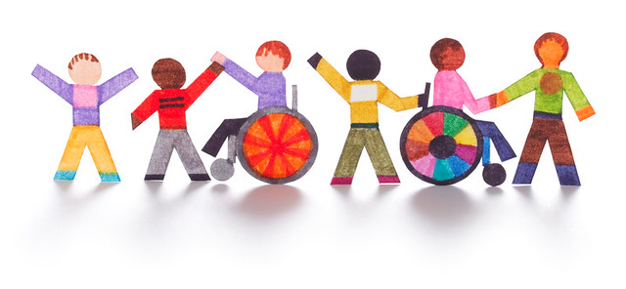
Pedagogical Environment
School culture would focus on inclusivity for everyone including race, culture, economic status, and disability (Hehir, 2015)
Behavior would be managed through the PBIS framework, which applies to all students in all parts of the school. Discipline would be constructed within this framework. Also through PBIS a physically and psychologically safe environment would become part of the culture of the school.
Social skills would be taught incidentally within the students’ natural environment and also as part of the curriculum. These social skills are important for creating the inclusive school culture.
Academics would be scaffolded for all students. Universal designs for learning would be implemented to give all students access to the same curriculum. Accommodations could be made for students with disabilities or students with a skill deficit. All academics would take place in the general education classroom with two co-teachers.
Understanding of local culture and different cultures of individuals within the community would be discussed with students to help foster the inclusive environment.

Slide 5
Relationships
Students
Students of all abilities will be in the same classroom supported by two co-teachers.
Staff
Staff will collaborate with students, families, and the community to provide quality education to all students
Families
Families will be active collaborators in the education of their students
Community
Students will be active participants in their community through volunteering and community outings
The community will be invited to participate in the school district through volunteering, community events, and community training
State Education Agency
The district will comply with all the requirements of the SEA and the SEA will support the district in its processes

Slide 6
References
Bradshaw, C. P., Waasdorp, T. E., & Leaf, P. J. (2012). Effects of school-wide positive behavioral interventions and supports on child behavior problems. Pediatrics, 130(5), e1136–e1145. doi:10.1542/peds.2012-0243
Brown, N. B., Howerter, C. S., & Morgan, J. J. (2013). Tools and strategies for making co-teaching work. Intervention in School and Clinic. 49 (2) pp. 84-91.
Crowley Independent School District. (2019). District improvement plan. Retrieved from https://www.crowleyisdtx.org/cms/lib5/TX01917780/Centricity/Domain/4//District%20Improvement%20Plan/2019%20District%20Improvement%20Plan%20Jan%20Formative.pdf
Hehir, T. (2005). Toward ending ableism in education: The promise of universal design. In New directions in special education: Eliminating ableism in policy and practice (pp. 85-110). Cambridge, MA: Harvard Education Press.
Horner, R. H., Sugai, G., & Lewis, T. (2015). Is school-wide positive behavior support an evidence-based practice? Retrieved from https://www.pbis.org/research

